Slide 1

Maximizing Engagement with Machine Learning
When should advertisers post new campaign content to leverage trends and maximize engagement?
Current ad campaigns fail to leverage trends.
Short life-cycles require agile advertising methods.
Machine Learning may provide evidence to disrupt social media advertising strategies and returns.

Slide 2

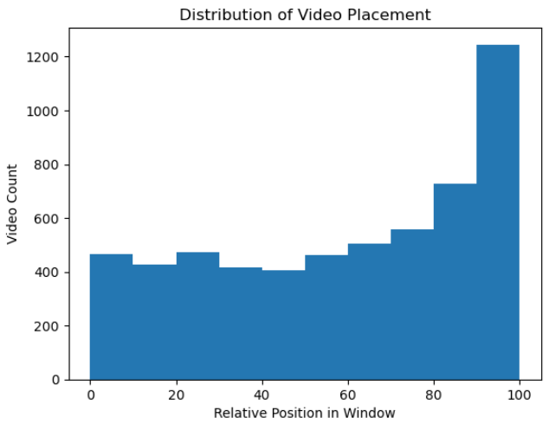
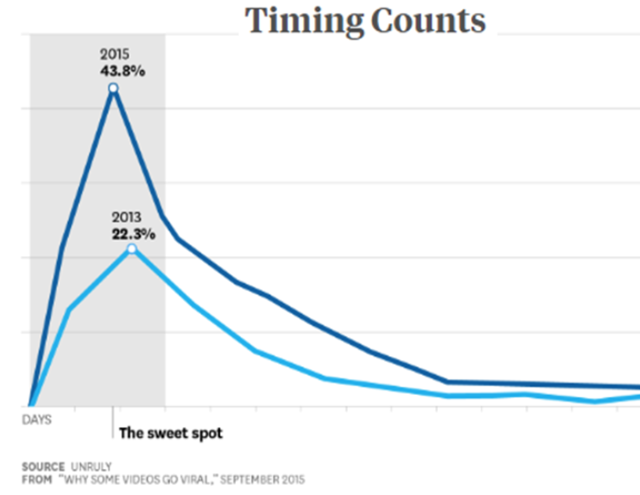
Data
Data obtained from TikTok API
Hosted on GitHub by Ivan Tran “How to Become TikTok Famous”
6 CSV files with many duplicates
52k Observations, 15 features
Metadata on Users and Videos
Target Variable: Engagement
Video creation is right-skewed.
Cleaning
Research reveals engagement patterns.
Duplicate records removed
Datetime converted from Unix to Datetime
Multiple features engineered
Removal of “Original Sounds”
Grouped by Song Title as the trending property of videos
Harvard Business Review

Slide 3
Feature Exclusion
Modeling
Linear Regression
Decision Tree Regressor (optimized at max depth 7)
Random Forest Regressor
MLP Regressor
Neural Network Regression
Likes
Comments
Shares
Views
Song Uses
Window
Window Position
Engagement Rate
Preprocessing
Train, Validation, Test Split
Standard Scaler
Four Feature Sets Created Binarized Song Titles Binarized Hashtags Binarized Songs & Hashes Titles & Hashes Excluded
Each model was iterated over the four Feature Sets
R² metrics were collected

Slide 4
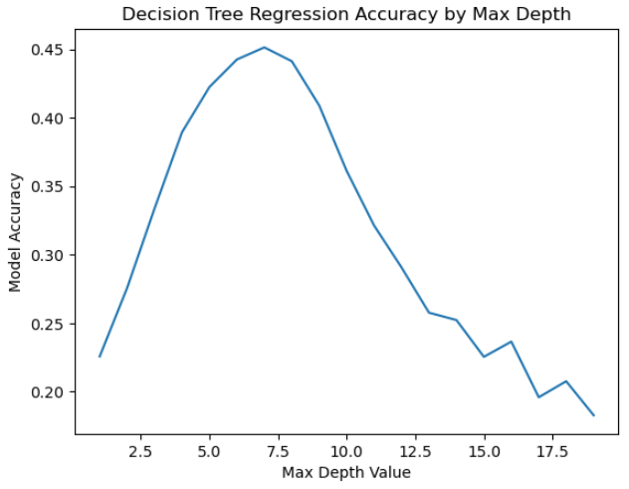
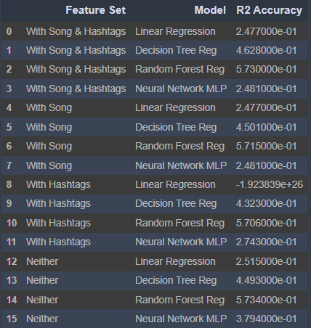
Performance
Insignificant performance difference between feature sets.
Optimized Max Depth

Slide 5
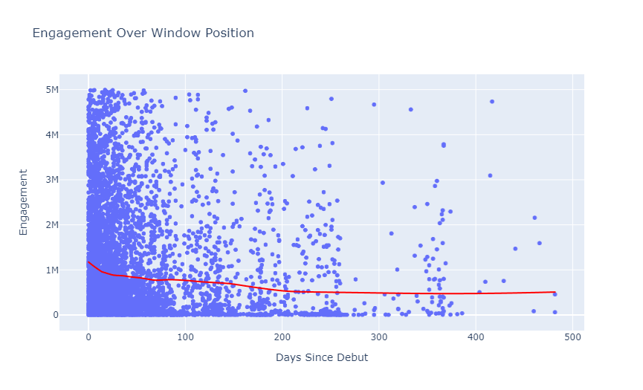
Insights
Production times exceed viable engagement windows.
Leveraging trends requires a more agile marketing approach.
Questions
Specific Bands of creation/engagement outside of trend pattern.
RNN applications over days of use window.

